Slide 1
HYATT – Hotel Data Analysis
TEAM 2
ISHANI JARIWALA
MONIKA PAWAR
POOJA GODHWANI
SAI PRAVINDAR MOHAN
TUSHAR BADLANI
ARIJIT NANDY
KIRTI JAISINGHANI

Slide 2
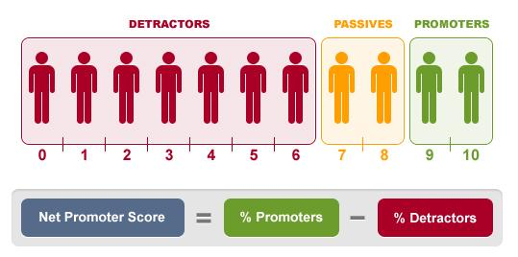
NPS - Net Promoter Score
Focus is on increasing NPS
Analyzing data patterns in USA hotels filtered by
Likelihood /driving factors
Purpose of visit/Food & beverages
Revenue/Length of stay
Recommendations to improve business

Slide 3
Initial Approach
Data Analysis on entire dataset
Replacing NA’s with mean
Couldn't find a meaningful NPS
We discover there were serious flaw with the approach

Slide 4
Approach 1
Data Cleaning
Drilling down to United States
Focus on Purpose of Visit
Calculating NPS w.r.t States

Slide 5
Purpose Of Visit
Business
Leisure
1,00,014
20,314
Notes:
20314

Slide 6
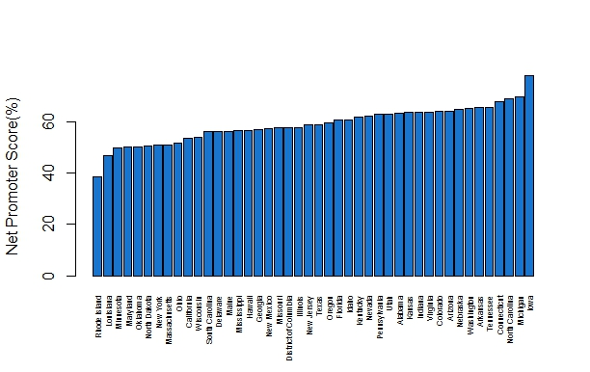
Bar Plot of NPS score on States
Rhode Island has the least NPS score – 38.48 (Highest 77.91)

Slide 7
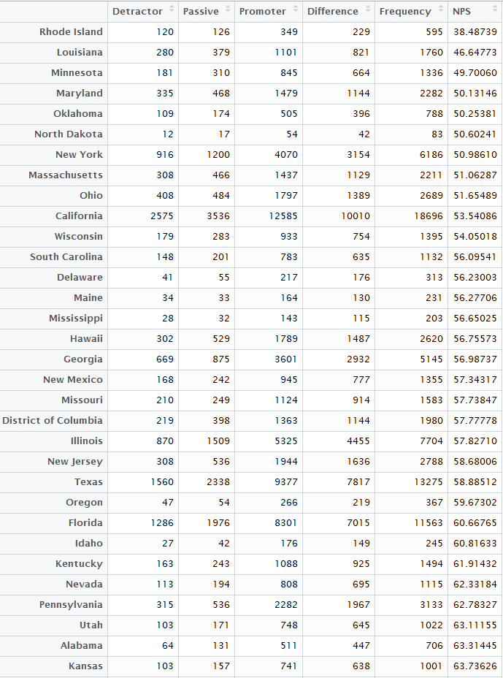
Promoters/Detractors/Passives distribution

Slide 8
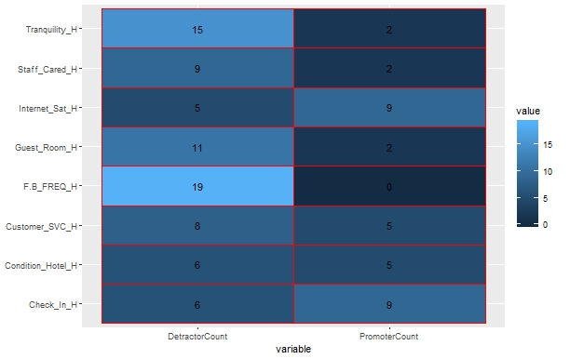
Detractor Vs Driving parameters Score Index on Rhode Island

Slide 9
Recommendations – Rhode Island
Customer Satisfied
Needs Improvements
Food and Beverages
Tranquility
Check-in Process
Guest Rooms
Internet Services
Staff Cared
Notes:
Food and beverages – No ratings above 3
Tranquility – Nearly 11 out of 15 has rated less than 3

Slide 10
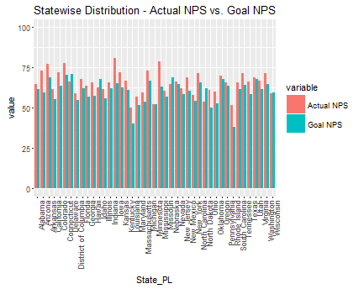
Hotel NPS Goal vs. Likelihood to recommend
Missouri
Hawaii
Connecticut

Slide 11
Approach 2
Likelihood to recommend
Finding out detractors w.r.t State
Finding 1 :
Arkansas has least customer Services rating
Finding 2 :
Maine has least Tranquility rating

Slide 12
Likelihood to Recommend on USA

Slide 13
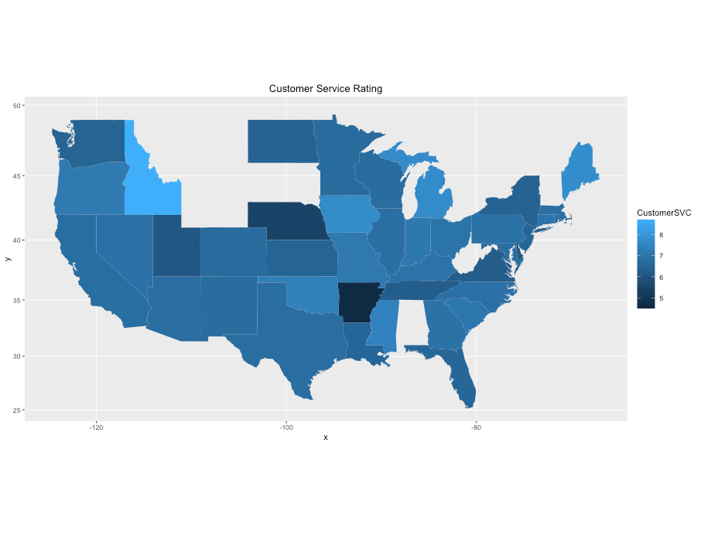
Detractors - Customer Service Rating per state
Arkansas has the least rating

Slide 14
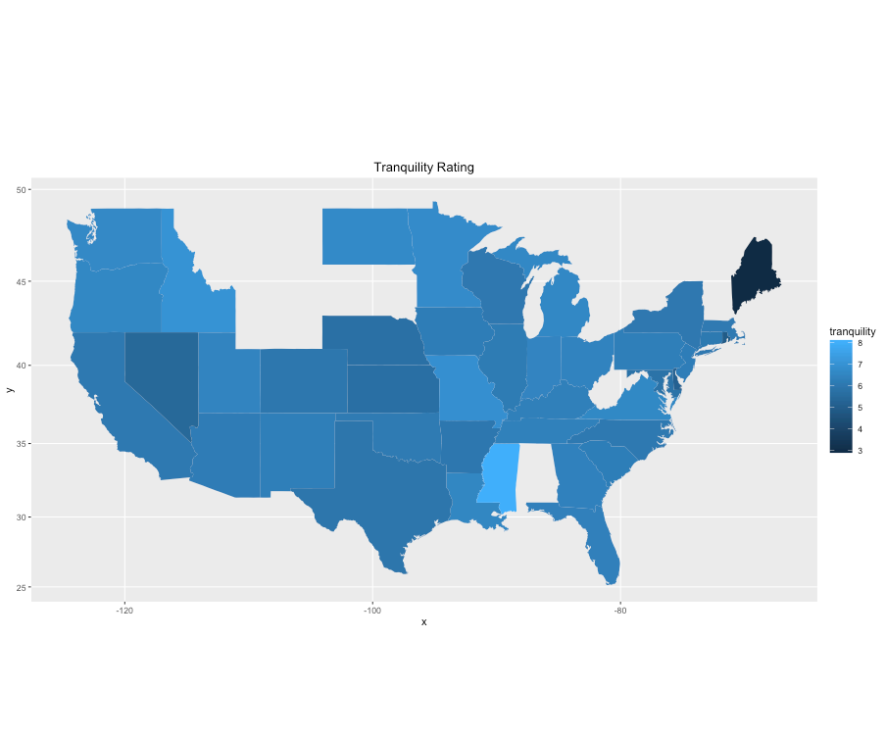
Detractors- Tranquility rating per state
Maine has the least rating

Slide 15
Recommendations
To Improve likelihood to recommend
Improve customer services in Arkansas
Take care of tranquility issues in Maine
Notes:
Food and beverages – No ratings above 3

Slide 16
Approach 3
Finding out food and beverages overall experience by the number of times customer visited outlet
Calculating detractors, promoters and passive based on the length of stay of customers
Finding 1 :
Majority of Detractors and passive visited outlet only once or twice

Slide 17
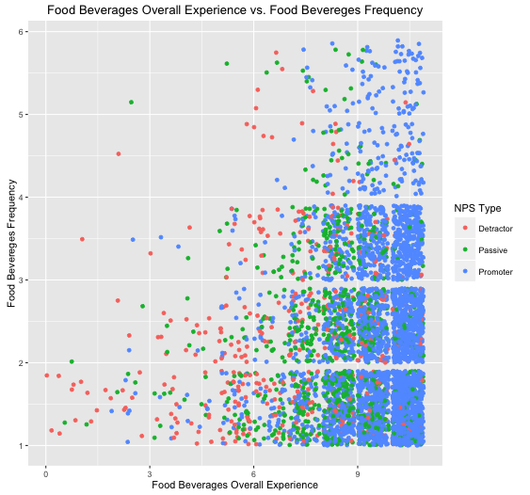
Business customers – Food Experience

Slide 18
Recommendations
Focus on advertising for food and beverages outlets
Improve Food and beverages experience of customers
Notes:
Food and beverages – No ratings above 3

Slide 19
Thank You !!

